Slide 1
lasso regression
MENU
ANALYSIS
CONTACT
Data ANALYSIS
How to use
In python
Presented by M. Saftian Kodja

Slide 2
TABLE OF CONTENT
Introduction
Modeling flow
01
02
Conclusions
03
MENU
ANALYSIS
CONTACT
Data ANALYSIS
This slide contains about what lasso regression is and what is needed in this project.
This slide contains about flow of modeling lasso regression using python
Yes, we get the conclusions and provide recommendations.

Slide 3
Introduction
01
MENU
ANALYSIS
CONTACT
Data ANALYSIS

Slide 4
What is lasso regression?
MENU
ANALYSIS
CONTACT
Data ANALYSIS
As we know, regression is a modeling task that involves predicting a numeric value given an input. Linear regression is the standard algorithm for regression that assumes a linear relationship between inputs and the target variable.
Lasso Regression is a popular type of regular linear regression. This has the effect of shrinking the coefficients for the input variables that do little to contribute to the prediction task. It allows some coefficient values ​​to be zero, allows input variables to be effectively removed from the model, provides a type of automatic feature selection.

Slide 5
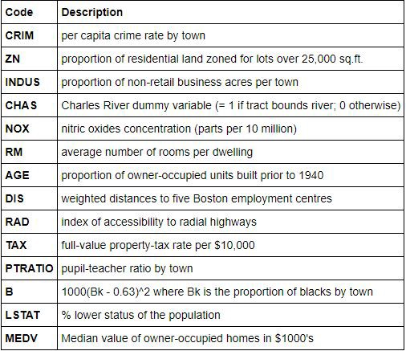
What data will we use in this project?
MENU
ANALYSIS
CONTACT
We will use the "Housing Values ​​in Suburbs of Boston" data. You can find this data from Kaggle.
The Boston data frame has 506 rows and 14 columns.
The medv variable is the target variable

Slide 6


What tools are used?
Google colab
jupyter
MENU
ANALYSIS
CONTACT
Data ANALYSIS

Slide 7
Modeling flow
02
MENU
ANALYSIS
CONTACT
Data ANALYSIS

Slide 8
Modeling flow: lasso regression
MENU
ANALYSIS
CONTACT
Split the data
01
02
Multicollinearity check
80% train and 20% test
Calculate VIF score for each feature
Correlation analysis to drop redundant feature
Model diagnostic
04
03
Fit the model on training data
R-square score on training data
Define and fit Lasso()
05
Model evaluation
RMSE, MAE, and MAPE

Slide 9
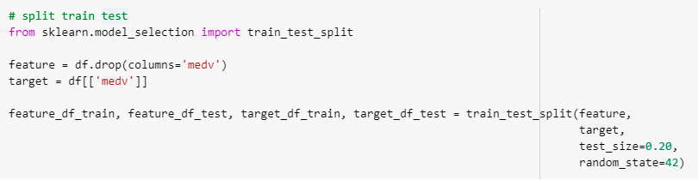
Split the data
MENU
ANALYSIS
CONTACT
Data ANALYSIS
01
Using train_test_split() function:
we want to predict ‘medv’.

Slide 10
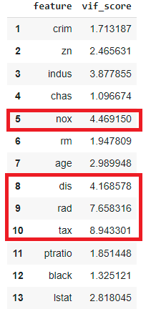
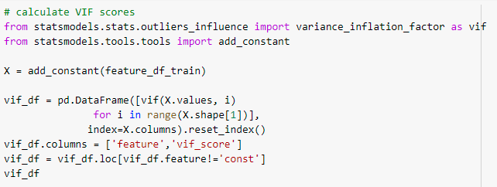

Multicollinearity check
MENU
ANALYSIS
CONTACT
Data ANALYSIS
02
Using statsmodels library.
We can detect multicollinearity by computing VIF score for each feature:
VIF = 1 → No multicollinearity
VIF between 4 and 10 → Moderate multicollinearity
VIF > 10 → Severe multicollinearity

Slide 11
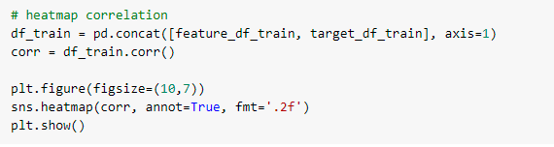
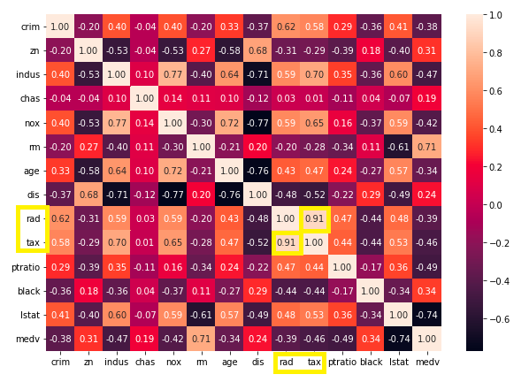

Multicollinearity check
MENU
ANALYSIS
CONTACT
Data ANALYSIS
02
To prevent multicollinearity, we can draw a correlation heatmap.
Using sns.heatmap() function:
We have 2 independent variables that have a correlation of more than 0.8. Therefore, we need to drop:
rad and tax from model.
Repeat the previous process to see if multicollinearity still occurs or not.

Slide 12
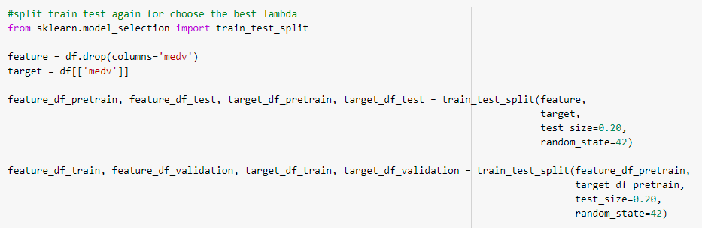
Fit the model on training data
MENU
ANALYSIS
CONTACT
Data ANALYSIS
03
To fit the model, we need to train test again for chose the best lambda (Alpha).
For lambdas in (0.01, 0.1, 1, 10)
Don’t forget to define new function.

Slide 13
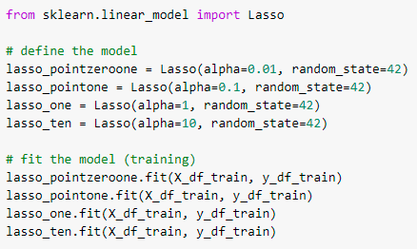
Fit the model on training data
MENU
ANALYSIS
CONTACT
Data ANALYSIS
03
Define the model and fit the model.

Slide 14
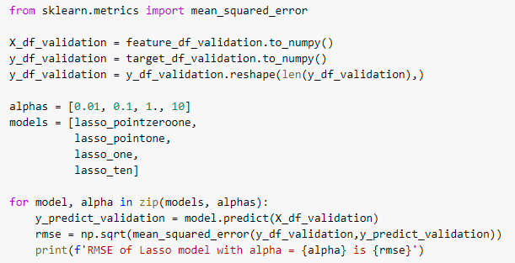

Fit the model on training data
MENU
ANALYSIS
CONTACT
Data ANALYSIS
03
Choose the best lambda from the validation set
We get the best lambda when alpha is 1. Because the values of RMSE when Lambda=1 is smaller than others.

Slide 15
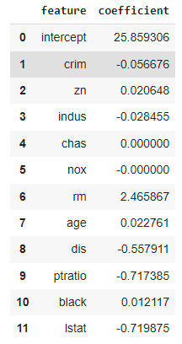
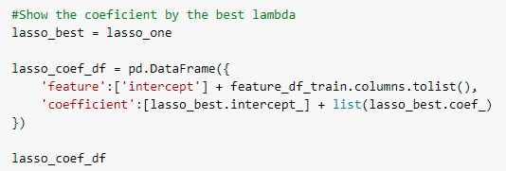
Model diagnostic
MENU
ANALYSIS
CONTACT
Data ANALYSIS
04
Show coefficient by using the best lambda model.

Slide 16
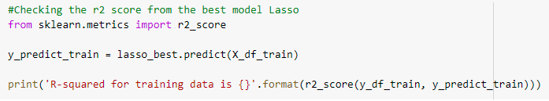
Model diagnostic
MENU
ANALYSIS
CONTACT
Data ANALYSIS
04
Checking R-Square from model with the best lambda.
We get thats R-squared is 0.688. Thats meaning 68,83% of variabillity of medv is successfully explained using all the features in the model. And thats good for using this model

Slide 17
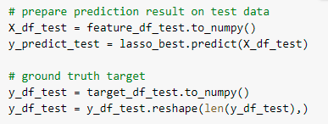
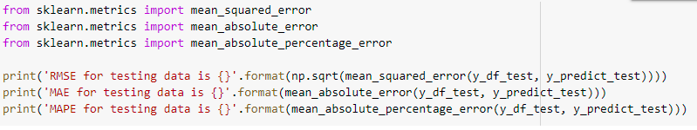

Model evaluation
MENU
ANALYSIS
CONTACT
Data ANALYSIS
05
We need to define new prediction result on test data.
RMSE: The standard deviation of predictions errors is 5.158 from the regression line, the residuals mostly deviate between +- 5.158.
MAE: On average, our predictions deviates the true medv by 3.446.
MAPE: Moreover, this is equivalent to 18.22% deviation relative to the true medv.

Slide 18
Conclusions
03
MENU
ANALYSIS
CONTACT
Data ANALYSIS

Slide 19
Conclusions
MENU
ANALYSIS
CONTACT
Data ANALYSIS
From Lasso Regression, we know the boston data frame have 13 independent variable’s and 1 dependend variable. But from the results of the method that was run, it turned out that 2 variables did not match the model to be run. Therefore, these variables must be excluded from the model, so that the model obtained from the regression lasso is as follows:
Medv = 25.86 – 0.057 crim + 0.021 zn – 0.028 indus + 0.000 chas – 0.000 nox + 2.466 rm + 0.023 age - 0.558 dis - 0.717 ptratio + 0.012 black - 0.720 lstat
Besides that, from this model, we can see that some automatic variables have been excluded from the model which is has a coefficient of zero.

Slide 20




Thanks!
MENU
ANALYSIS
CONTACT
Data ANALYSIS
www.linkedin.com/in/saftian-kodja
+62 823 4914 0222
https://github.com/safkodja
saftian.kodja@gmail.com

